Slide 1


Introduction to Foundation Models
Foundation Models
Coined in 2001 by the Stanford Team
Concept inspired form the self-supervised learning

Slide 2
Introduction to Self-Supervised Learning
Supervised Learning
Unsupervised Learning
Self Supervised Learning
Performs well on labeled data
Decent amount of labeled data is needed
Label Creation is a manual process
Performs well on unlabeled data
Not really effective compared to supervised learning
No external labeled dataset is needed
Training labels are created for free from the unlabeled dataset

Slide 3


What is Self Supervised Learning?
Next word prediction
Training Data
I am going to play
I am going to
play
Input
Output

Slide 4
What is Self Supervised Learning?
Next word prediction
I am going to
Model
play

Slide 5

What is Self Supervised Learning?
Self Supervised Learning learns the representation form the unlabeled data.
Representation

Slide 6
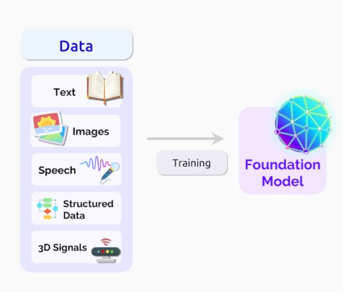
AI model trains on very large "unlabeled" datasets using self-supervised learning.

Slide 7
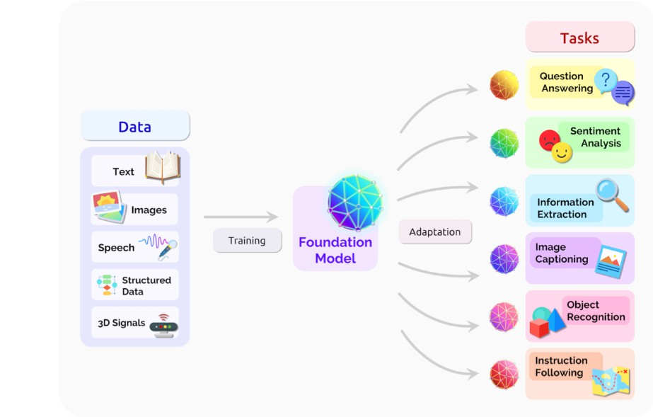

Slide 8
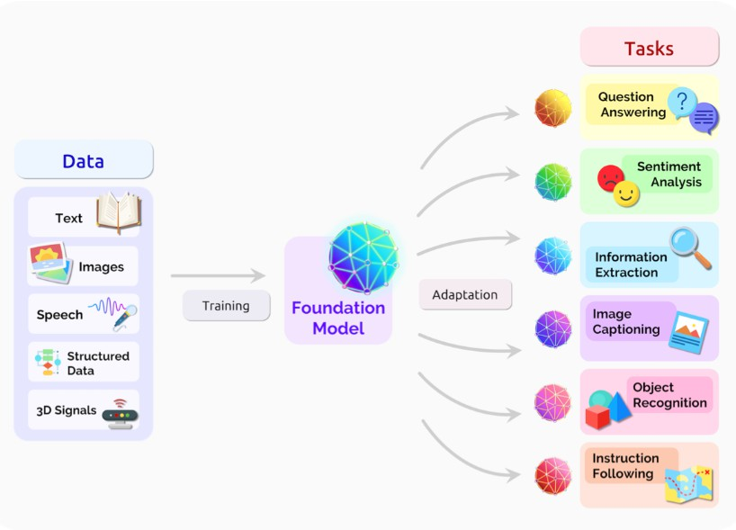
Single model for various use cases High-performance model
Minimal task specific data

Slide 9
Example: Voice cloning Application
Before Foundation models
Minimum 10 hours of training data
After Foundation models
Just 3 minutes of training data

Slide 10
Different types of Foundation Models
Depending on the class of datasets, foundation models can be classified into 2 types:
Unimodal Foundation models
Multimodal Foundation models

Slide 11
Unimodal Foundation Models
Unimodal Foundation models
Multimodal Foundation models
Deals with one class of dataset

Slide 12
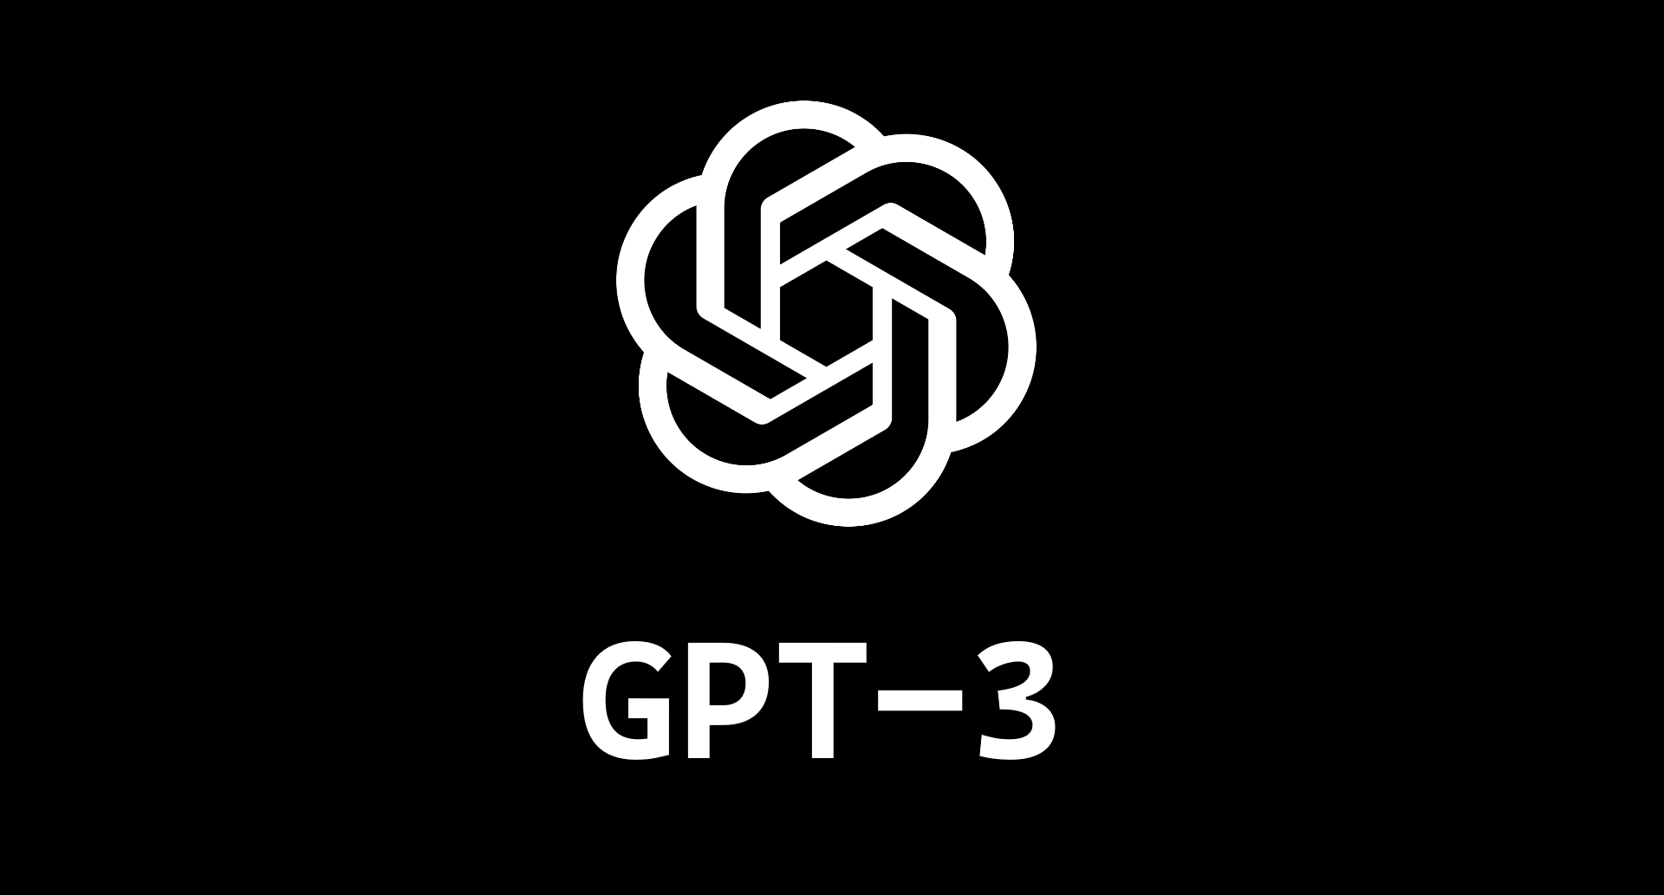
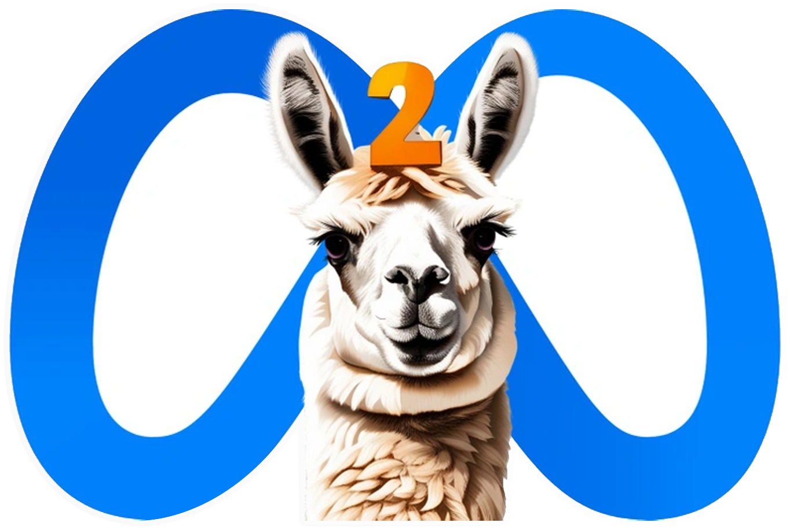


Examples of Unimodal Foundation Models

Slide 13
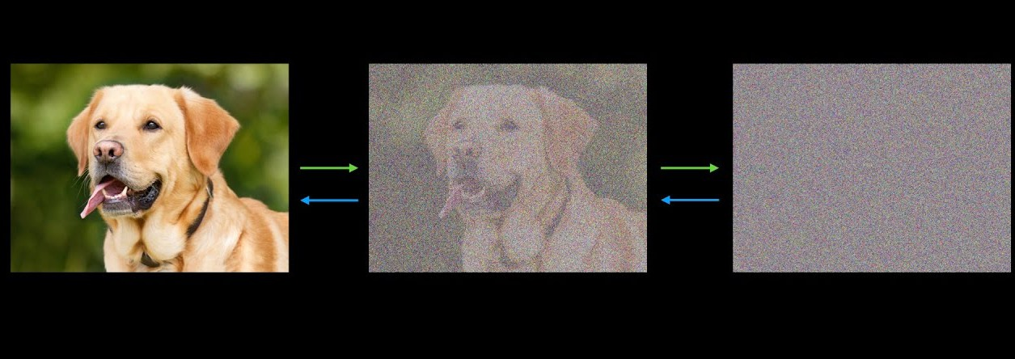
Examples of Unimodal Foundation Models
Diffusion Models

Slide 14
Multimodal Foundation Models
Unimodal Foundation models
Multimodal Foundation models
Deals with one class of dataset
Deals with more than one class of datasets

Slide 15



Examples of Multimodal Foundation Models
Stable Diffusion

Slide 16
Examples of Multimodal Foundation Models
AudioGen
AudioCraft

Slide 17
Thank You

